Slide 1
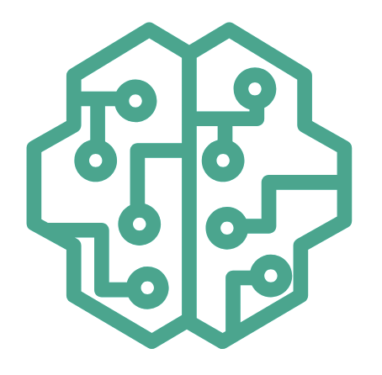
LLM Operations
(LLMOps)
Week 5
Tue 20 Aug

Slide 2
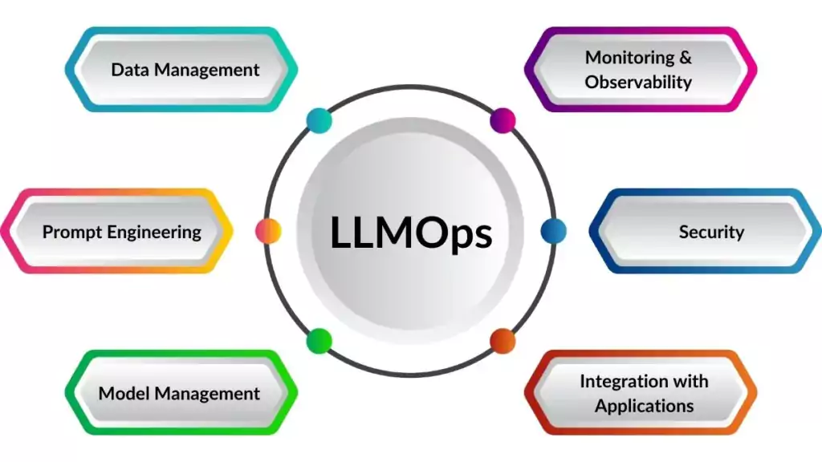
What is LLMOps ?
Definition
LLMOps or large language model operations, refers to the practices and processes involved in managing and operating large language models (LLMs) and applications based on LLMs.

Slide 3
What is LLMOps ?
LLMOps vs MLOps
LLMOps is a specialized subset of MLOps (machine learning operations), which focuses specifically on the challenges and requirements of managing LLMs.
While MLOps covers the general principles and practices of managing machine learning models, LLMOps addresses the unique characteristics of LLMs and applications based on LLMs like RAG systems.

Slide 4
Benefits of LLMOps
Pros
Performance
LLMOps tools and techniques can help to optimize the performance of LLMs by identifying and resolving bottlenecks. This leads to improved accuracy, faster response times, and better overall user experiences.
Scalability
LLMOps provides a scalable and flexible framework for managing LLMs and LLM based applications enabling organizations to easily adapt to changing demands and requirements.
Efficiency
LLMOps streamlines the entire life cycle of LLMs and LLM based applications, from data preparation and model training(if needed) to deployment and monitoring. Automated tools and standardized processes improve efficiency by reducing manual tasks, optimizing resource utilization, and minimizing the time required for model development and deployment.

Slide 5
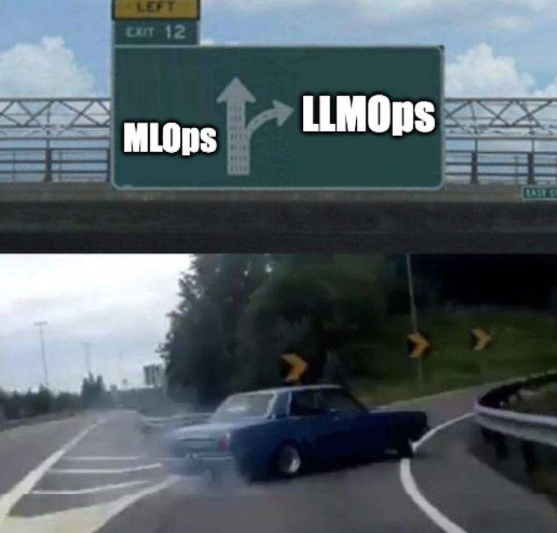
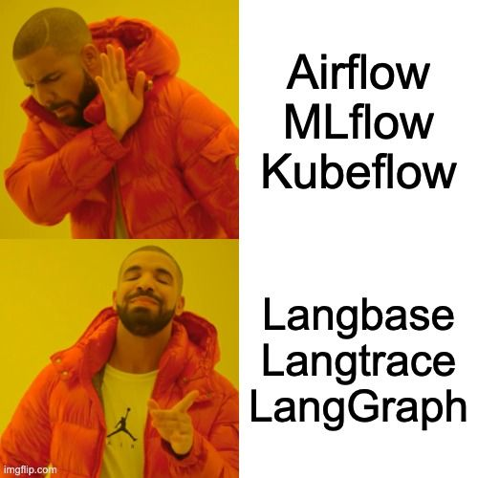
LLMOps Tooling
Tools and Platforms

Slide 6
LLMOps Tooling
Tools and Platforms
Component | Tools
Orchestration | LangChain, LlamaIndex, LangGraph, DSPY, Haystack, *AWS Bedrock
Monitoring & Observability | Langfuse, LangSmith, Langtrace, Phoenix AI - Arize, *MLflow
Evaluation | Ragas, DeepEval, TruLens
*MLOps & LLMOps Landscape Research

Slide 7
LLMOps Tooling
LangChain & Llamaindex
LangChain & Llamaindex are orchestration tools/frameworks created for developing application based around LLMs. They have a lot of components which make the whole process of development, productionalization and deployment of LLMs and LLM based application much easier. They provide different components for:
Prompts, Prompt Templating and Engineering
LLMs from different providers like AWS Bedrock, OpenAI…
Output parsers
Loaders, parsers for different types of data (documents)
Embedding models from different providers
Vector Stores(Databases), Retrievers and indexings from different providers
Compositions creators based around LLMs like Tools, Agents, Chains

Slide 8
LLMOps Tooling
Langfuse
Langfuse is a open source platform dedicated to LLM engineering in overall but mostly specializing in monitoring of LLMs and LLM based applications, observability, tracing in LLM applications, managing prompts and evaluation of the tracings (traces).
Langfuse can be used in two ways:
On their own cloud, hosted and provided by them
Self-hosted on AWS

Slide 9
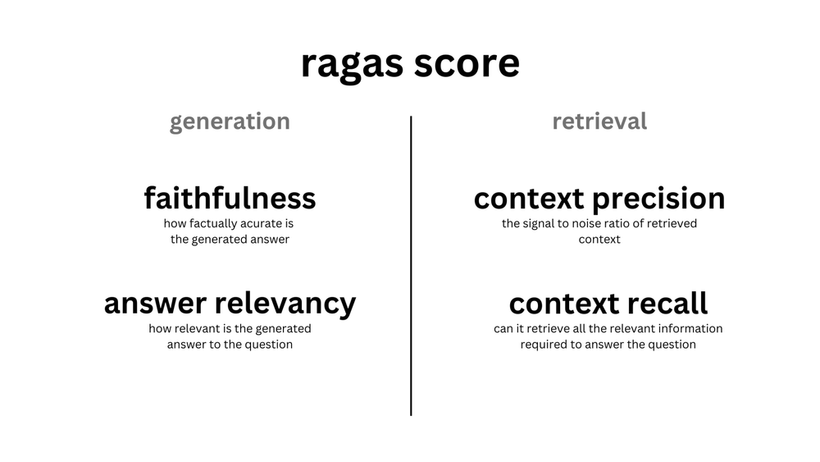
LLMOps Tooling
Ragas
Ragas is a framework is used for evaluating LLM applications like Retrieval Augmented Generation (RAG) pipelines. Ragas aims to create an open standard, providing developers with the tools and techniques to leverage continual learning in their RAG applications. Ragas evaluates the pipeline by:
Synthetically generate a diverse test dataset used for the evaluation of the app/pipeline
Use LLM-assisted evaluation metrics designed to objectively measure the performance of the application
Monitors the quality of your apps in production using smaller, cheaper models that can give actionable insights.
Uses these insights to iterate and improve the application.

Slide 10
Hands - On

Slide 12
Q&A

